Slide 1
Checkpoints

Slide 2
Checkpoints
A Checkpoint is a verification point that compares a current value for a specified property with the expected value for that property.

Slide 3
How Does a Checkpoint Work?
When you add a checkpoint, QuickTest adds a checkpoint with an icon in the test tree, and adds a Check CheckPoint statement in the Expert View.
When you run the test, QuickTest compares the expected results of the checkpoint to the current results. If the results do not match, the checkpoint fails

Slide 4
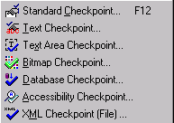
Insert => Checkpoint

Slide 5
Standard Checkpoint
The Standard Checkpoint checks a variety of
objects such as buttons, radio buttons, combo
boxes, lists, etc.

Slide 6
Creating Standard Checkpoint
Choose Insert > Checkpoint >Standard Checkpoint.
Click the object you want to check. The Select an Object dialog box opens.
Select the item you want to check from the displayed object tree. The tree item name depends on the object’s class
Click OK. The Checkpoint Properties dialog box opens.
Click OK to close the dialog box.
A tree item with a checkpoint icon is added to your test tree.

Slide 7
Text Checkpoint
checks that a text string is displayed in the appropriate place in your application or on a Web page.
For Web, mySAP, Siebel, PeopleSoft, and Terminal Emulator applications

Slide 8
Creating a Text CheckPoint
Highlight a text string on the page or screen.
Choose Insert > Checkpoint > Text Checkpoint
Click the text string.The Text Checkpoint Properties dialog box opens.
Specify the checkpoint settings.
Click OK to close the dialog box.
A tree item with a checkpoint icon is added to
your test tree.

Slide 9
TextArea Checkpoint
checks that a text string is displayed within a defined area in a Windows application, according to specified criteria.
For Windows-based applications - Standard Windows, Visual Basic, ActiveX, and .NET Windows Forms.
Note: Text Area checkpoints are supported in Windows NT, Windows 2000, and Windows XP only.

Slide 10
Creating TextArea Checkpoint
Choose Insert > Checkpoint > Text Area Checkpoint.
Define the area containing the text you want QuickTest to check by clicking and dragging the crosshairs pointer.
Click OK to close the dialog box.
A tree item with a checkpoint icon is added to
your test tree.

Slide 11
Bitmap Checkpoint
checks an area of your Web page or application
as a bitmap.

Slide 12
Creating Bitmap Checkpoint
Choose Insert > Checkpoint > Bitmap Checkpoint
Click an object to check in your Web page or application.
Click OK. The Bitmap Checkpoint Properties dialog box opens.
  If you want to check a small area of the bitmap, click the Select Area button.Use the crosshairs pointer to specify a small area.
Click OK to add the bitmap checkpoint to your test.
A tree item with a checkpoint icon is added to your test tree.

Slide 13
Database Checkpoint
Checks the contents of the database accessed.
You can use database checkpoints in your test to check databases accessed by application and detect defects.
You define a query on your database, and then you create a database checkpoint that checks the results of the query.
There are two ways to define a database query:
  Use Microsoft Query.
  Manually define an SQL statement.

Slide 14
In QuickTest, you create a database checkpoint based on the results of the query you defined on a database. QuickTest captures the current information about the database and saves this information as expected data.
A database checkpoint is inserted into the test script. This checkpoint is displayed in your test script as a DbTable.Check CheckPoint statement and as a step in the Tree View

Slide 15
Accessibility Checkpoint
identifies areas of your Web site that may not conform to the World Wide Web Consortium (W3C) Web Content Accessibility Guidelines.

Slide 16
XML Checkpoint
Checks the contents of the XML documents. You
can create two types of XML checkpoints:
  XML Application Checkpoints:
  check an XML document within a Web page.
  XML File Checkpoints:
  check a specified XML file.

Slide 17
Creating XML Checkpoint
Choose Insert > Checkpoint > XML Checkpoint (File)
The XML Checkpoint from File dialog box opens.
Specify the path of an XML file.
Select the element(s) and/or value(s) that you want to check.
Click OK to add the XML checkpoint to your test.

Slide 18
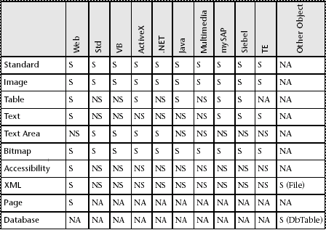
Checkpoints and Support Environments
S - Supported NS - Not Supported NA - Not Applicable

